Slide 1
Project Report
Qinyuan (David) Wei
Mentor: Wentai Liu
Date: 09/08/2017

Slide 2
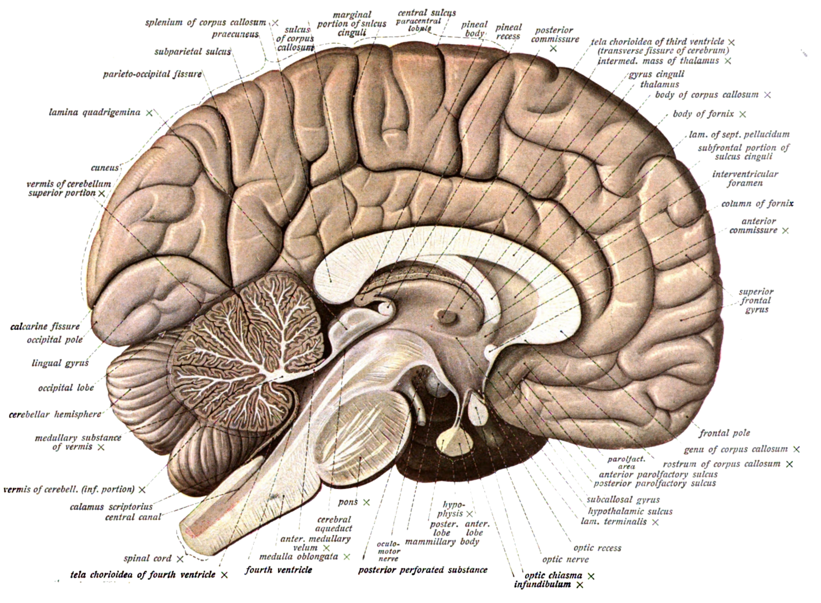
EEG source localization in 3D source model
New way:
Modify the source model
Keep cortex and thalamus

Slide 3

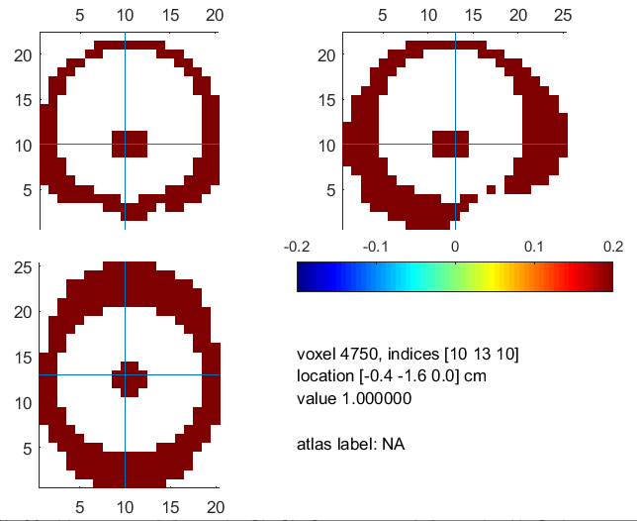
New Source Model
Prototype of the new source model:

Slide 4
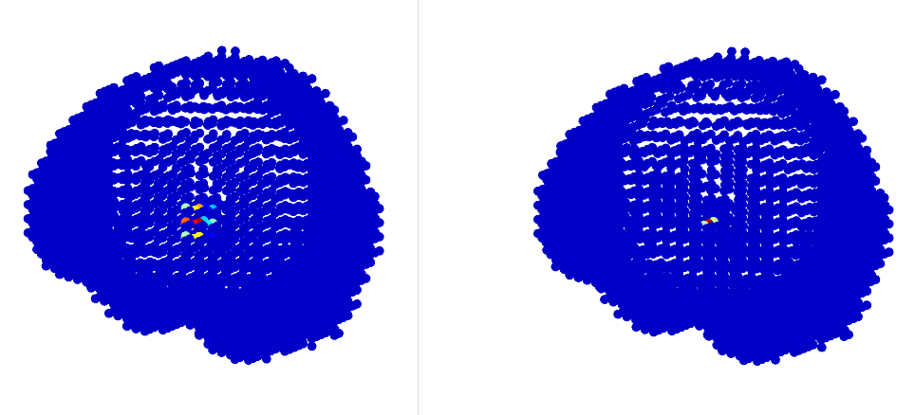
Results
1 source (deep):
DLE: 0mm
Result
Ground truth

Slide 5
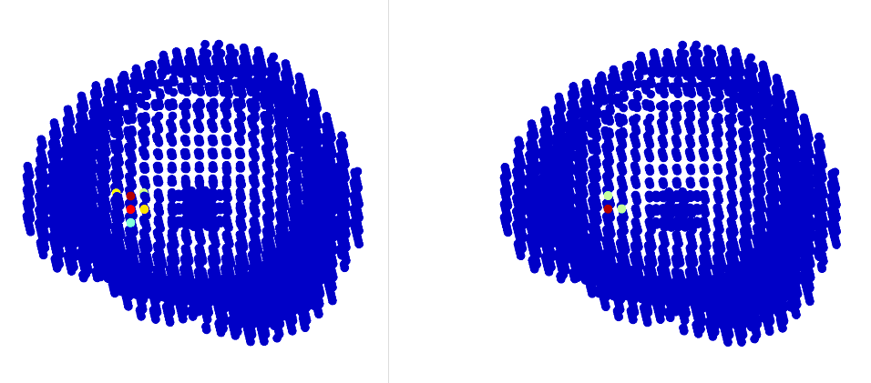
Results
1 source (surface):
DLE: 8mm
Result
Ground truth

Slide 6
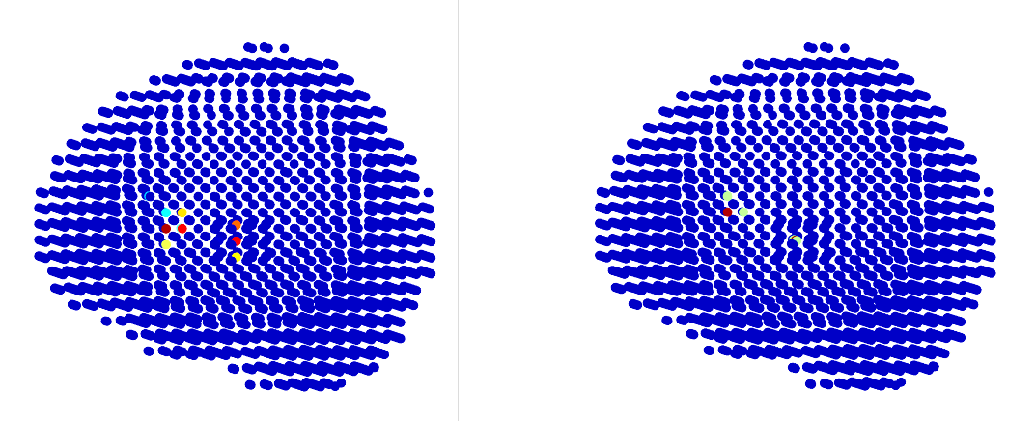
Results
2 sources: (1 deep 1 surface)
Notes:
Source on surface : DLE=8mm
Source deep : DLE=8mm

Slide 7
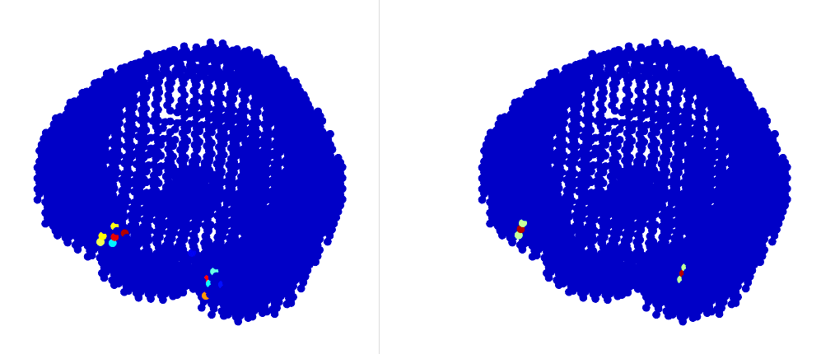
Results
2 sources: (2 surface)
Notes:
Left: 26.5mm
Right: 24mm

Slide 8
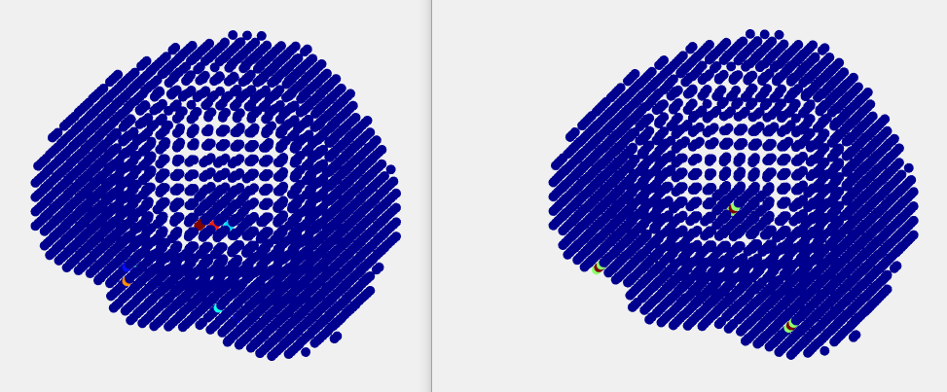
Results
3 sources:
Notes:
Deep source: DLE=11.3mm
Surface source left: 25.6mm
Right: 33.9mm

Slide 9
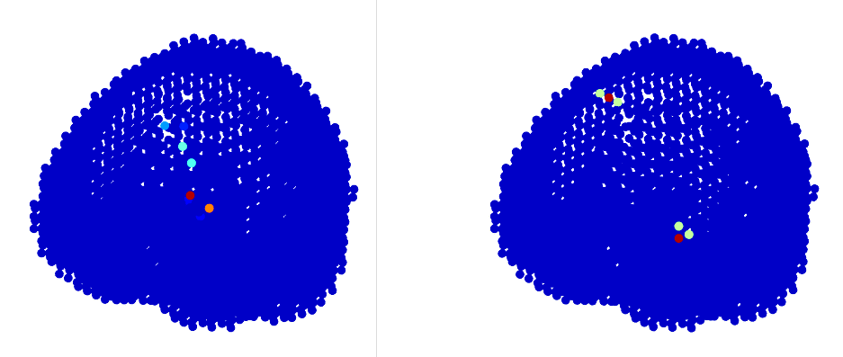
Some Problems
2 sources:
The model is too rough.

Slide 10
Next Step
Build a more accurate source model
Implement other methods
Continue my work in Beijing

Slide 11
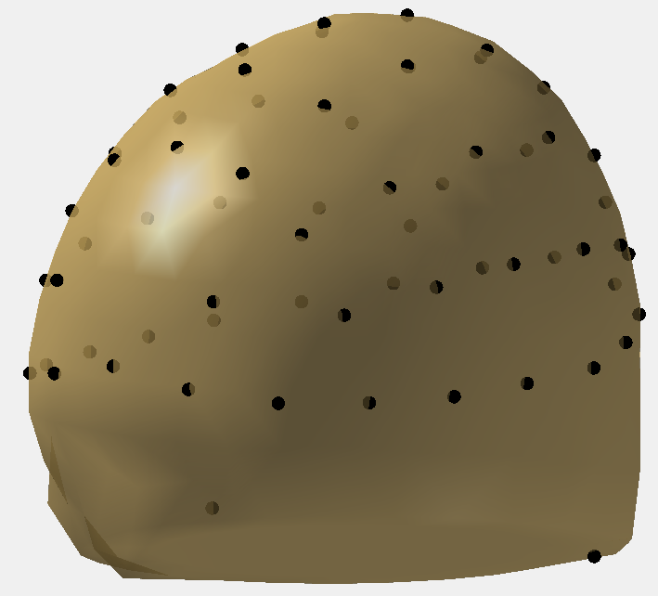
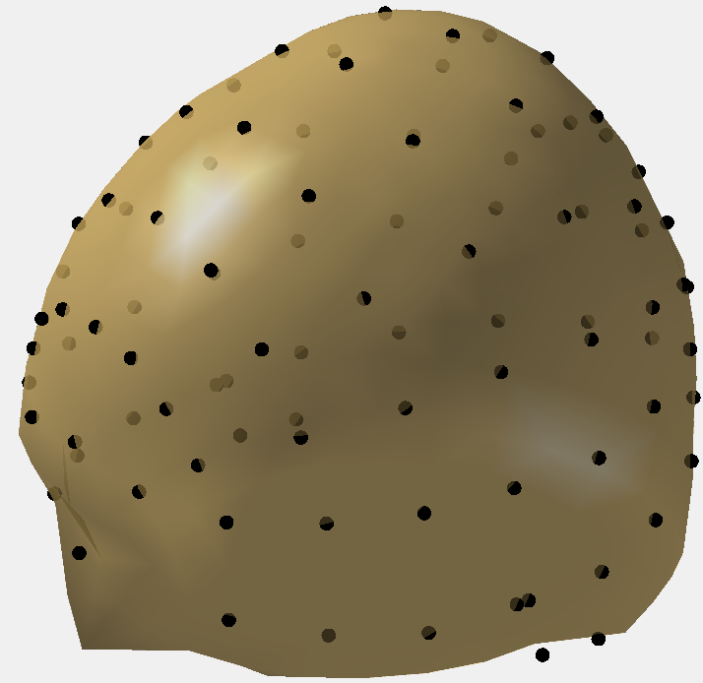
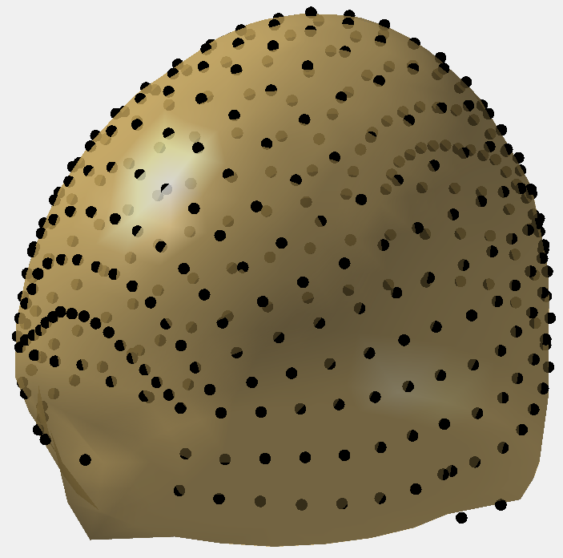
The relationship between spatial resolution and number of electrodes
10-20: 64 electrodes
10-10: 97 electrodes
10-5: 346 electrodes

Slide 12
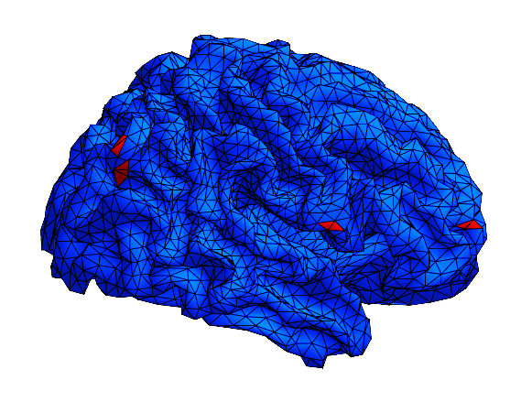
The relationship between spatial resolution and number of electrodes
Ground truth：

Slide 13
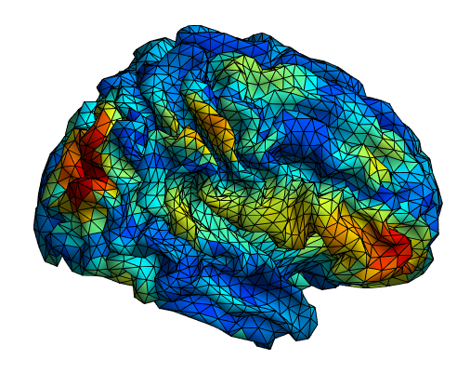
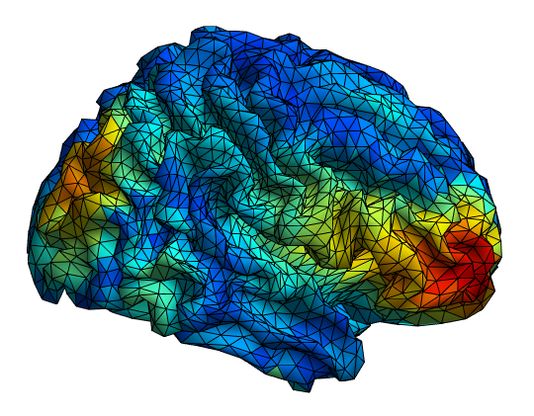
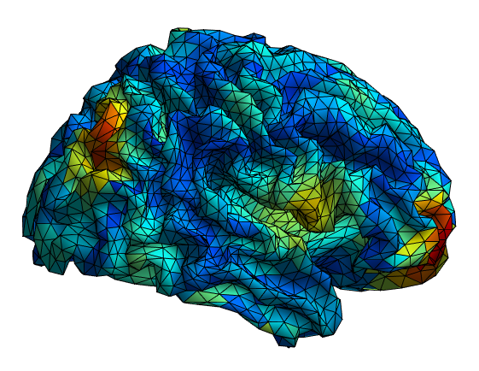
The relationship between spatial resolution and number of electrodes
Results:
10-20: 64 electrodes
10-10: 97 electrodes
10-5: 346 electrodes
Notes:
sLORETA

Slide 14
The relationship between spatial resolution and number of electrodes
More electrodes ---- higher spatial resolution

Slide 15
Thanks for your time

Slide 16
Summary
Inverse problem
Multiple methods tested on 3D grid model
Explanation of the incapability of regularization methods
Modify the source model

Slide 17
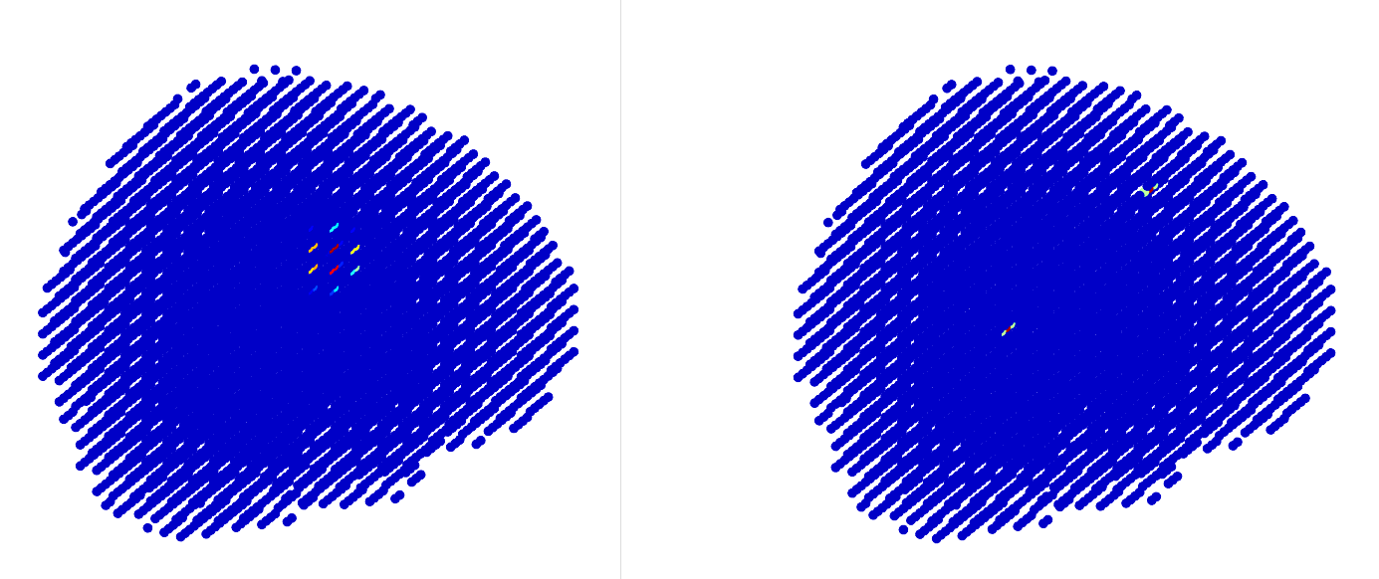
MCE
2 sources
Result
Ground truth
Notes:
Then I test 2 sources in the brain. As we can see, the result is totally wrong. And the position of the reconstructed result is in the middle of 2 ground truth sources. This is a typical bias of regularization method.

